Slide 1
caArray Silver Compatibility Review
Juli Klemm
Steve Lustbader
Rashmi Srinivasa
Maki Duncan
NCICB
September, 2008

Slide 2
Agenda
caArray overview (Available only for reference)
  Overview and background
  Domain model
  Architecture
  APIs
caBIG compatibility review
  Project information and submission package
  Changes from 2.0 (last silver review) to 2.1.0
    Domain model
    API services

Slide 3
Overview of caArray
caArray is a web and programmatically accessible array data management system. caArray supports the annotation and exchange of array data using a federated model of local installations whose results are shareable across caBIG™.
Technical strengths
  Simplified domain model and API (from caArray 1.x)
  Efficient storage and retrieval of microarray data
  Support for MAGE-TAB import
  Focus on usability
Targeted user community
  Bench scientists performing microarray data collection and annotation
  Microarray core facility scientists
  Bioinformatics and data management coordinators
  Multi-institutional data coordinating center informaticists

Slide 4
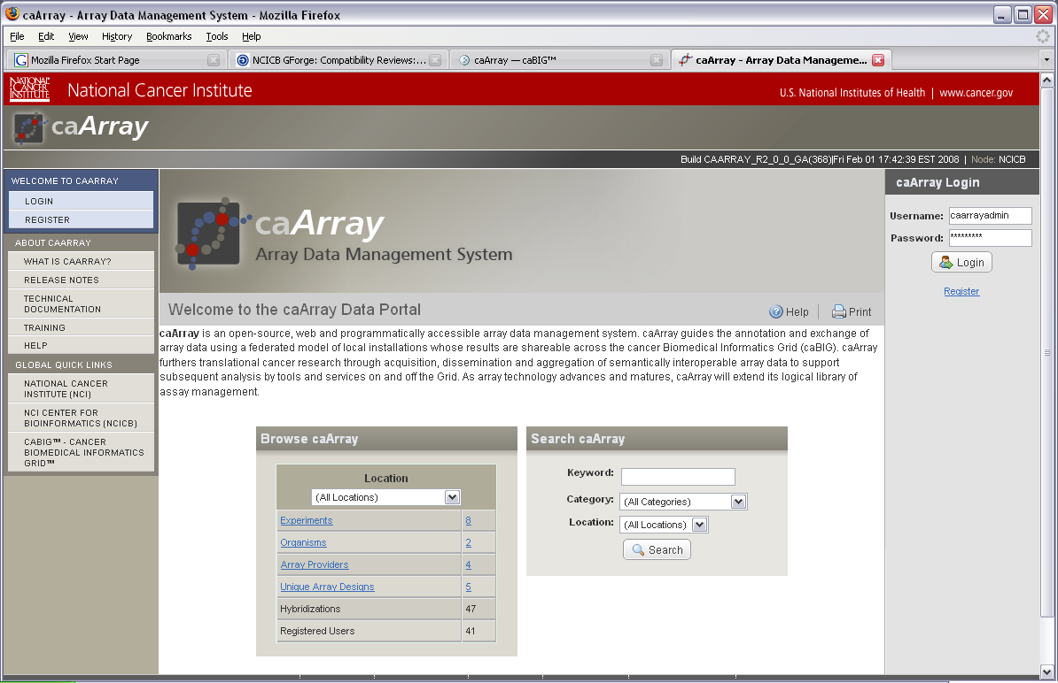
Overview of caArray

Slide 5
Overview of caArray: User Interface
User Interface:
  Browse and Search through the repository for Experiments of interest. The search mechanisms lead to actionable results that are clear to the end user and incorporate their specific rights for the experiments.
  Submit and access array data and annotations based on a role-based workflow designed to support collaboration between Principle Investigators, Lab Administrators, Scientists and Statisticians. The end-to-end states of an experiment are: Draft, In Progress, and Public.
  Upload, validate, and import single files or a set of zipped files. The workflow allows for the effort to be spread over time and in synch with the way work is performed in the lab but also offers the ability to perform bulk uploads of annotation and experiment data.
  Control the public visibility of an experiment. One can make Public the entire contents of an Experiment or limit public visibility to a defined set of Samples within an Experiment.

Slide 6
Overview of caArray: API and Bulk Import
Grid API and Remote Java API: Both interfaces provide access to the following services: search, parsed data set retrieval, file content retrieval and retrieval of array design details.
MAGE-TAB Support: MAGE-TAB files – IDF, SDRF, ADF – can be imported to allow bulk upload of experiment annotations and associated array data files. The original MAGE-TAB files are stored in the system intact and are available for download.

Slide 7
Overview of caArray: External Technologies and Standards Used
caGrid 1.2: The Introduce Toolkit provided by caGrid was used to generate the caArray grid service
Common Security Module (CSM): used to supply authentication, authorization and user provisioning for caArray 2.0.
MIAME: Minimum Information About a Microarray Experiment that is needed to enable the interpretation of the results of a microarray experiment and potentially to reproduce the experiment.
MAGE-TAB: A tab-delimited, spreadsheet-based format to annotate and communicate array data in a MIAME-compliant fashion.
MGED Ontology: Ontology for describing samples used in a microarray experiment

Slide 8
caArray Domain Model
Model captures…
  microarray data, annotation and workflow as simply as possible
  MAGE-TAB, caArray 1.x data etc. with high-enough resolution
Model is optimized…
  for efficient storage and transfer of microarray data
Reuse of existing classes from other models
  Protein Information Resource
  caBIO
Packages
  project, array, data, file, sample, protocol, vocabulary, contact, publication
  Consult Enterprise Architect model caarray_client_model for details.
History of implementation
  Used caCORE to generate original Java and caGrid artifacts
  Fixed and modified manually afterward

Slide 9
caArray Domain Model: Microarray Data Representation
Goals
  Represent data efficiently for management, marshalling and serialization
  Don’t require special data de-serialization or unpacking on the client
  Support packaging of only client-requested subset of data
Conceptually represented as a spreadsheet
  QuantitationTypes are the columns (relatively few)
  Probes/features are the rows (up to 1.5M+)
  For efficient storage and grid serialization, store values as large primitive arrays along the larger dimension
  XML representation in marshalling:
  <ns4:FloatColumn id="3" values="190.0 11263.3 164.0…” />

Slide 10
Architecture
caArray is a J2EE application using…
  EJB 3.0
  Hibernate 3.2
  Struts2
  MySQL 5.0
Front-end functionality
  Web-based UI
Programmatic access
  EJB remote interfaces via Java RMI
  caGrid interface to same methods exposed via EJBs: a Data Service and several Analytical Services for efficient data retrieval

Slide 11
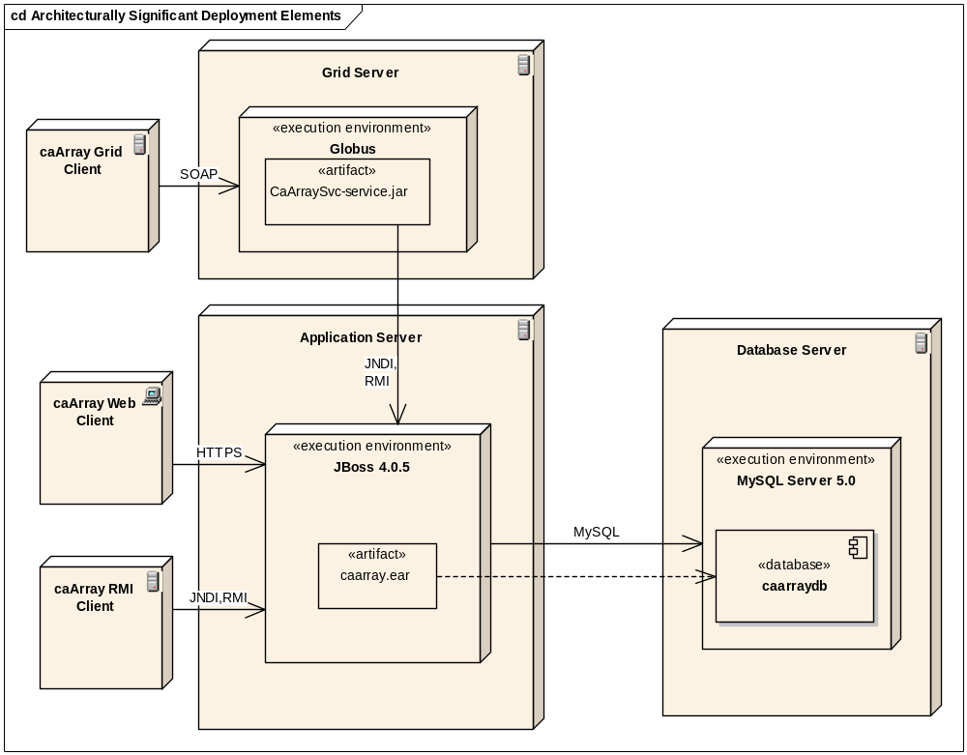
Architecture

Slide 12
caBIG compatibility review
caArray project on GForge https://gforge.nci.nih.gov/projects/caarray2
Source and documentation available via Subversion
https://gforge.nci.nih.gov/svnroot/caarray2
Silver compatibility submission package
  http://gforge.nci.nih.gov/frs/?group_id=108
Services are exposed on the grid
http://array.nci.nih.gov/wsrf/services/cagrid/CaArraySvc
caBIG compatibility submission package
  01. caarray_silver_compat_kickoff.ppt
  02. caarray_supplementary_specification.doc
  02. caarray_vision.doc
  03. caarray_software_architecture_document.doc
  05. approved_annotated_caArray_v2_1_rv2.xmi
  06b. caarray_siw_error_log.xml
  07. caarray_uml_loader_checklist.doc
  08. caarray_value_domain_report.csv
  09. caarray_vocabulary_report.doc
  10. caarray_standards_report.doc
  11. CDEBrowser_SearchResults.xls
  12. caArray_grid_client_api_doc.zip
  13. AdopterTestLog.zip
  14. caarray_object_io_svn_urls.txt
  16. caarray_use_case_summary.doc
  2.1.0 model change summary.txt
  caArray 2.1 CDE changes.xlsx

Slide 13
caBIG compatibility review: Changes from 2.0 to 2.1.0
Domain model changes
    AbstractBioMaterial.protocolApplications is now an ordered list instead of a set
    Hybridization.protocolApplications is now an ordered list instead of a set
    RawArrayData <-> Hybridization is now many-to-many
    ArrayDesign.designFile is now ArrayDesign.designFiles, with a many-to-many relationship between an arraydesign and a file
    Changes requested from the last review, including:
      droping the caTissue classes
      dropping the caBIO MicroArray class
API service changes
    New caGrid Analytical Service method to download the contents of a file using Grid Transfer:
    public org.cagrid.transfer.context.stubs.types.TransferServiceContextReference createFileTransfer(gov.nih.nci.caarray.domain.file.CaArrayFile caArrayFile)
    New test for the above: GridTransferFileDownload.java

